Slide 1
NIST(National Institute of Standards and Technology) Cloud Computing Model

Slide 2
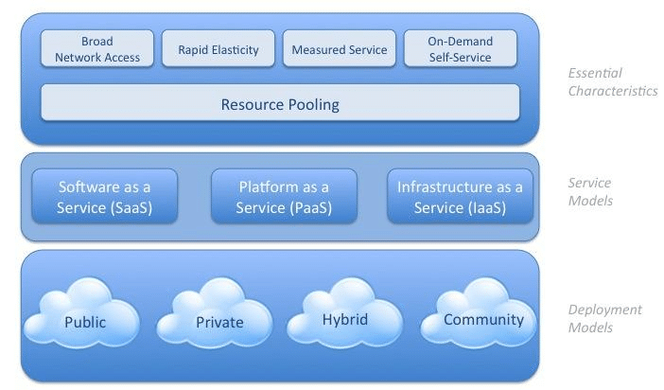
NIST Cloud Model Diagram

Slide 3
NIST (National Institute of Standards and Technology)
NIST defines a community cloud deployment model as one that is used exclusively by a specific community of consumers from organizations that have shared concerns (e.g., mission, security requirements, policy, and compliance considerations).

Slide 4
NIST Cloud Model Characteristics
NIST five essential characteristics of Cloud Computing –
1. On demand self-service. 2. Broad network access. 3. Resource pooling. 4. Rapid Elasticity. 5. Measured service

Slide 5
NIST model Objectives
Provides a simple and unambiguous taxonomy of three service models –
1. Software as a service (SaaS)
2. Platform as a service (PaaS)
3. Infrastructure as a service (IaaS)
and deployment models –
1. Private cloud,
2. Community cloud,
3. Public cloud, and
4. Hybrid cloud

Slide 6
NIST Model Five Spotlight Actors
It has 5 Major Components based on their roles, responsibilities, activities in cloud computing –
1. Cloud Consumer
2. Cloud provider
3. Cloud Broker
4. Cloud Auditor
5. Cloud Carrier

